Slide 1

JIRA / Innotas Integration - Overview
1 Project
New Agile Project Templates
New CapEx Questionnaire
Timesheet Rules to include Task Date governance
Notes:
Users ONLY see timesheet tasks that fall inline with the Plan Start and Plan Target Dates

Slide 2
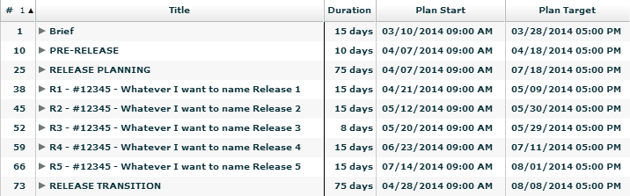
JIRA / Innotas Integration – Project Plan
Notes:
This is an Agile project. Nothing else has changed with the exception of the ‘Construct’ task. This task is now replaced by multiple Summary Release tasks. Summary means timesheet task.
You are now able to change the naming of your release tasks so that it makes more sense for the project and resources who will be booking their time. However, all release tasks must start with the same naming convention; this includes R1 – Project Number – Whatever you want to name the Release. The purpose of the R1 and Project Number in front of the Release task name is so that Accounting can distinguish which Release the hours are being booked to and can associate each release back to the project.
We have implemented timesheet rules where resources are unable to book time to tasks outside of the Plan Start and Plan Target dates in the Task tab of Innotas. This means that it’s imperative that you maintain your project dates within Innotas. We understand that there may be activities

Slide 3
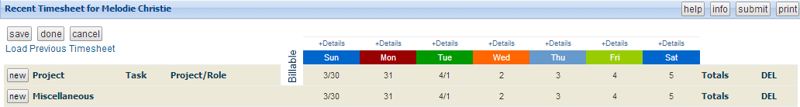
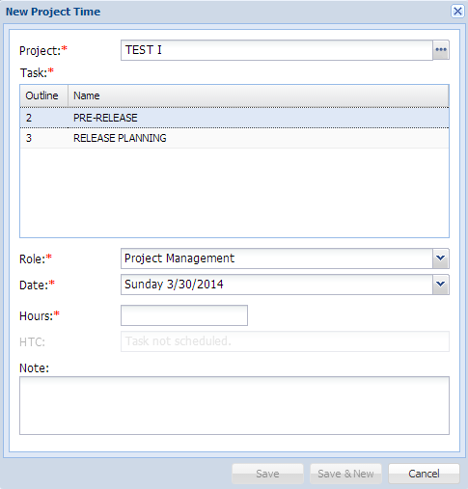
JIRA / Innotas Integration – Timesheet – R1
Notes:
Keeping in the mind the dates of Release 1, I’m completing my timesheet for the week of March 30th through April 5th. This is outside of the 10 day window and therefore you will not see Release 1 as a timesheet task.

Slide 4
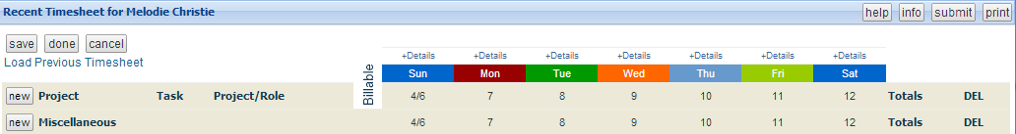
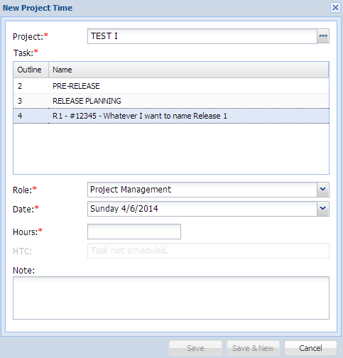
JIRA / Innotas Integration – Timesheet – R1
Notes:
I’ll select the subsequent timesheet, April 6th through April 12th which is within the 10 day window of the Plan Start date of Release 1 and therefore I will see Release 1 on my timecard.

Slide 5

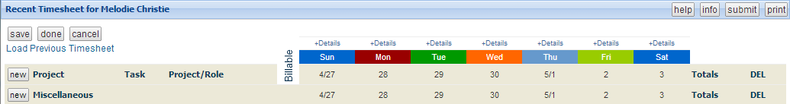
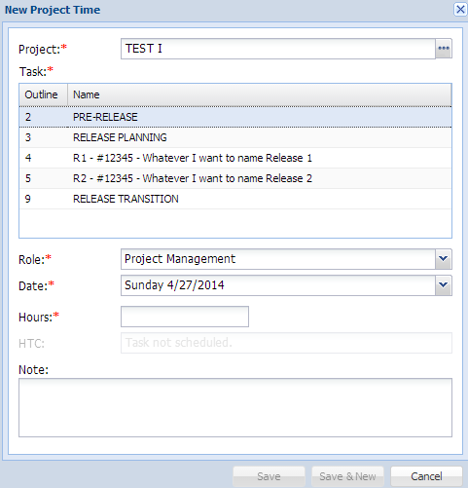
JIRA / Innotas Integration – Timesheet – R1
Notes:
I have here my Release 1 and Release 2 dates.
I’m working with the timecard of April 27th through May 3rd. This is within the Release 1 dates and 10 days within the dates of Release 2. You will notice that I see both Release 1 and Release 2 on my timecard.
Remember: time for Sprint Planning will go under Release Planning. In other words, you’re currently in Release 1 but planning for Release 2, your time will go under Release Planning.

Slide 6
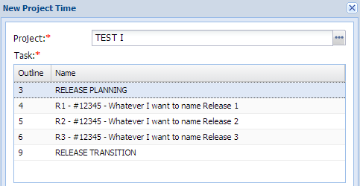
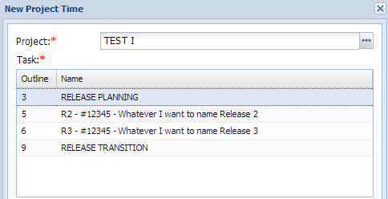
JIRA / Innotas Integration – Timesheet – R1
Notes:
So keeping the end date of Release 2 in mind, I will be able to book time to that task until 10 days after the Plan Target date ( ).
You’ll see the timecard starting with June 1st and I still am able to book time to Release One.
However, with the following week, starting June 8th my time card no longer gives me Release One.

Slide 7
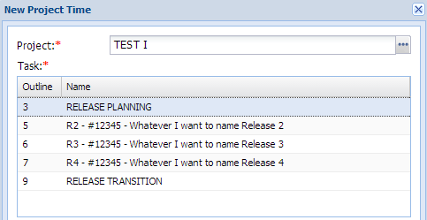
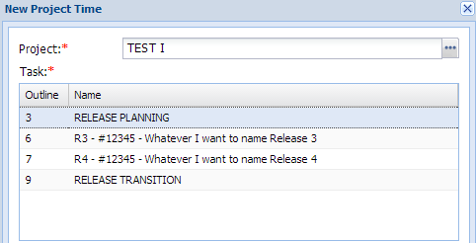
JIRA / Innotas Integration – Timesheet – R2
Notes:
And I can book time to Release Two up to 10 days after the Plan Target Date.

Slide 8

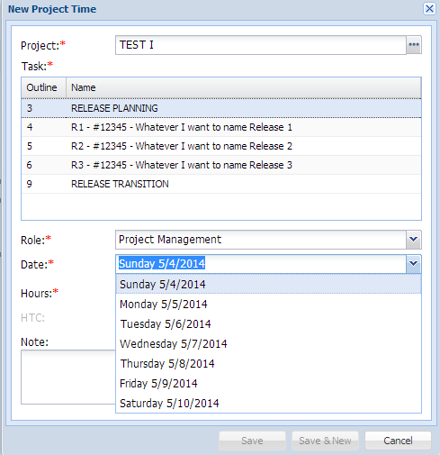
JIRA / Innotas Integration – Timesheet – R3
Notes:
So what if your Sprint does not start on Monday and end on a Friday.
Here I have my Release 3 start on a Tuesday and end on a Thursday. 10 days prior to 5/20 is 5/10. I open the timesheet for May 4th through May 10th. Although 10 days is on Saturday, the user will still be able to book time towards this task (Release 3) on any day of that week.

Slide 9
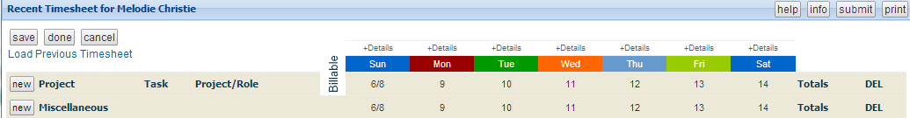
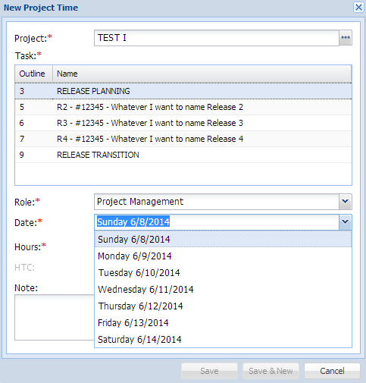
JIRA / Innotas Integration – Timesheet – R3
Notes:
So what if your Sprint does not start on Monday and end on a Friday.
Here I have my Release 3 start on a Tuesday and end on a Thursday. 10 days prior to 5/20 is 5/10. I open the timesheet for May 4th through May 10th. Although 10 days is on Saturday, the user will still be able to book time towards this task (Release 3) on any day of that week.
So 10 days after the Plan Target date of 5/29 is June 8th which is a Sunday. So I select the timecard of June 8th through June 14th and I am able to book time towards the Release 3 not only on June 8th but any day of that week.

Slide 10
Jira\Innotas – Key Integration Features
User Friendly Interface
Customized Innotas/Jira Mapping Plugin
Ability to filter Innotas projects based on Business Units
Ability to search on Innotas Projects from Project Dropdown
Ability to do a lookup on all the corresponding Innotas Releases defined under an Innotas project
Ability to sync up all old issues in case mappings are changed
Ability to view if Innotas Project is of type Agile or Waterfall
Ability to search on Key Innotas Attributes from Issue Search Screen for reporting
Ability to update the Jira Release name based on Innotas Release name
Validations in place to make sure Jira Release names & Innotas Release names match

Slide 11
Jira\Innotas – Key Integration Use Cases
Use Case1 : Save Innotas/Jira Release Mapping for “Agile Project” = Yes. In this scenario Jira Release name & Innotas Release name should match and will be mandatory
Use Case2 : Save Innotas/Jira Release Mapping for “Agile Project” = No. In this scenario it is not required to map an Innotas Release to Jira Release. However if users still want to map the two releases then both the names should match
Use Case3 : Map Multiple Jira Releases to Multiple Innotas Releases
Use Case4 : Ability to search on key Innotas attributes within Jira

Slide 12
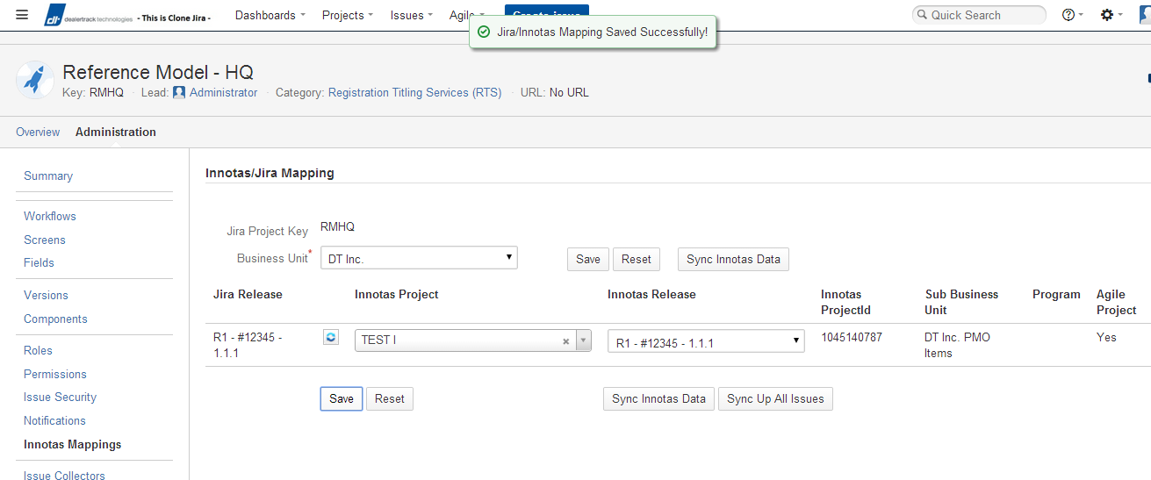
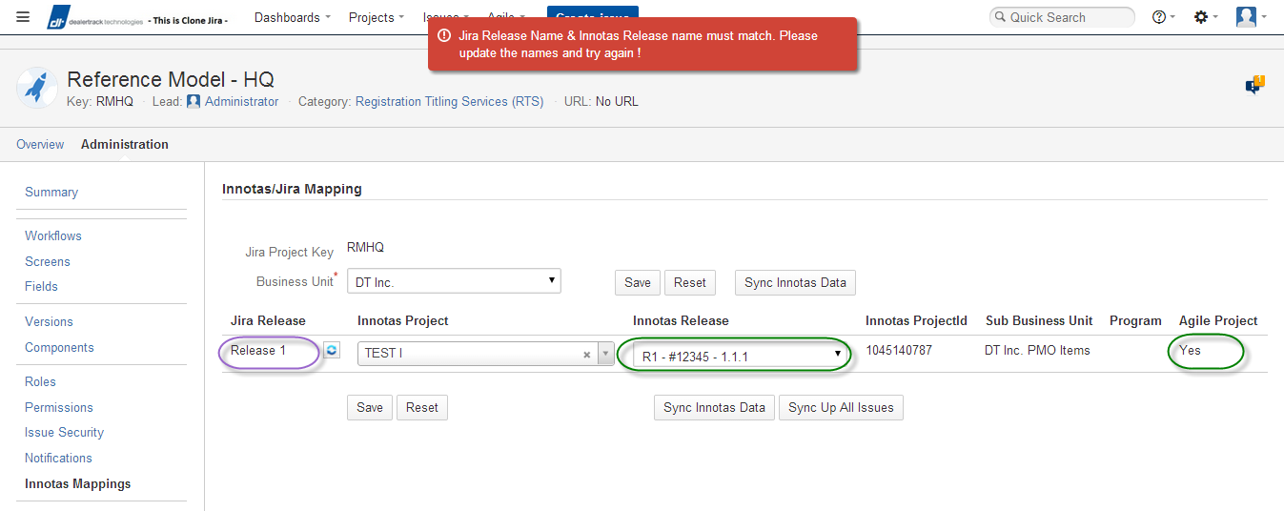
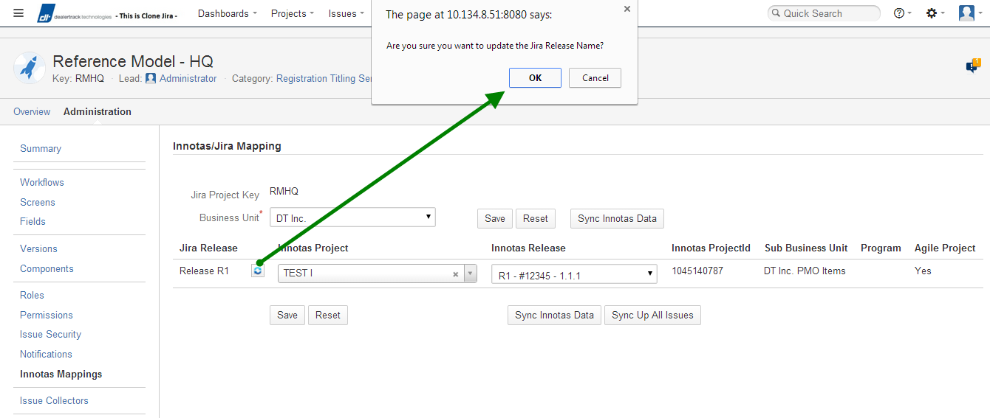
JIRA / Innotas Integration – Agile Project = Yes
Use Case 1
Notes:
Save Innotas/Jira Release Mapping for “Agile Project” = Yes. In this scenario Jira Release name & Innotas Release name should match and will be mandatory. In case user want to update the jira release name they can click on the icon next to the Jira Release name which will go and update the Jira Release Name based on the Innotas Release name

Slide 13
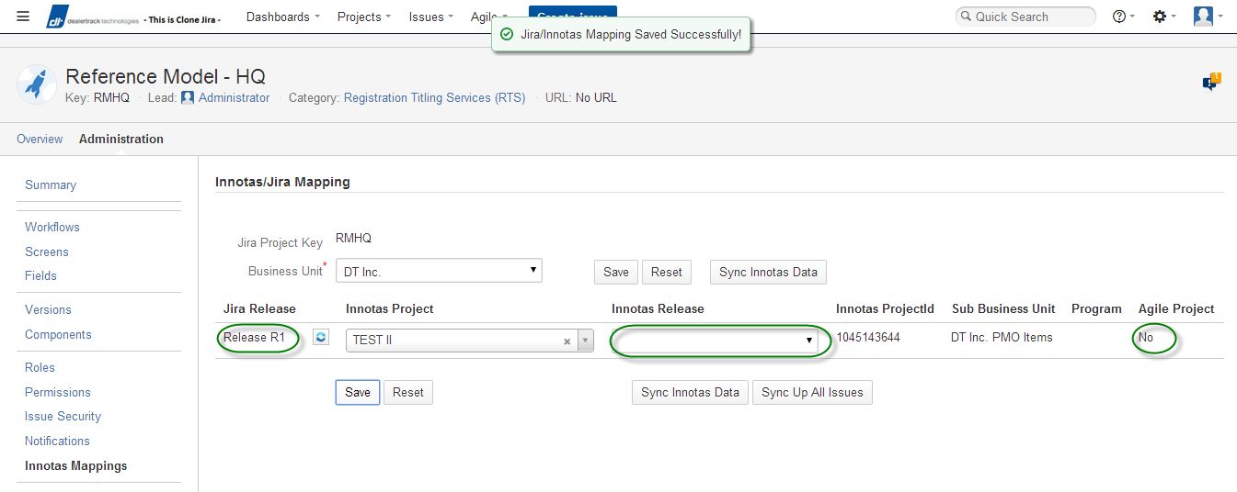
JIRA / Innotas Integration – Agile Project = NO
Use Case 2
Notes:
Save Innotas/Jira Release Mapping for “Agile Project” = No. In this scenario its not mandatory to map an Innotas Release name . In case user wants to still map an Innotas Release , both the release names should match. In case user want to update the jira release name they can click on the icon next to the Jira Release name which will go and update the Jira Release Name based on the Innotas Release name

Slide 14
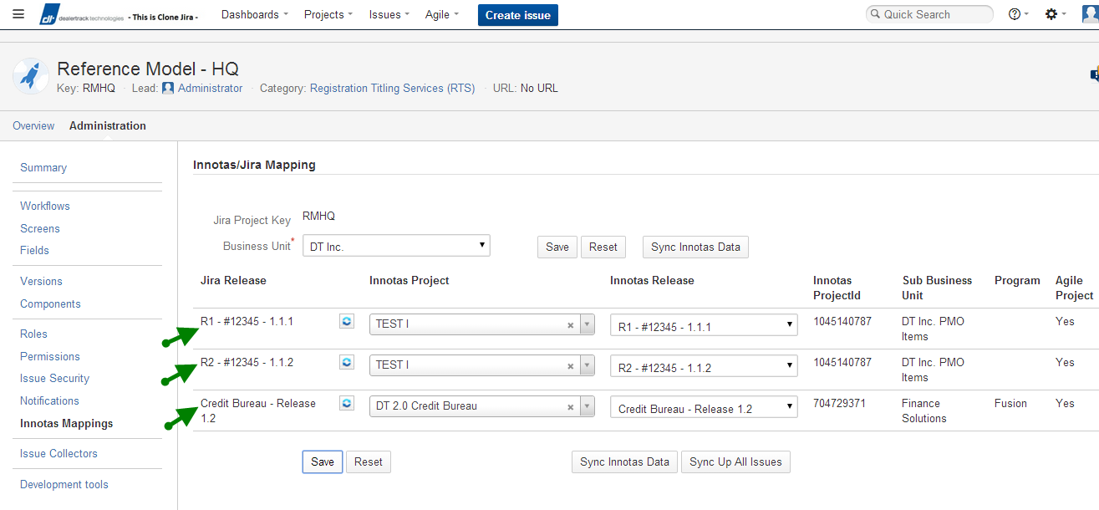
JIRA / Innotas Integration – Multiple Release Mappings - Use Case 3
Notes:
Save Innotas/Jira Release Mapping for “Agile Project” = No. In this scenario its not mandatory to map an Innotas Release name . In case user wants to still map an Innotas Release , both the release names should match. In case user want to update the jira release name they can click on the icon next to the Jira Release name which will go and update the Jira Release Name based on the Innotas Release name

Slide 15
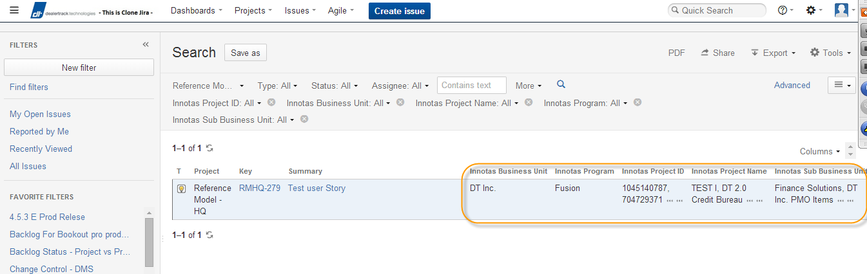
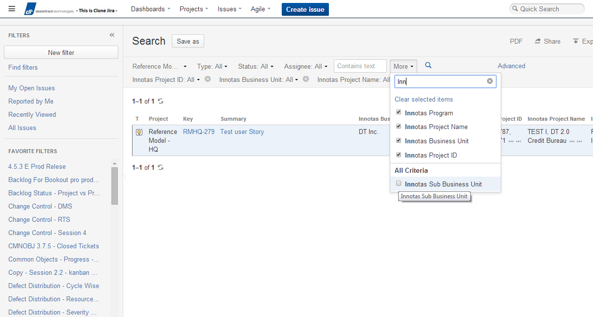
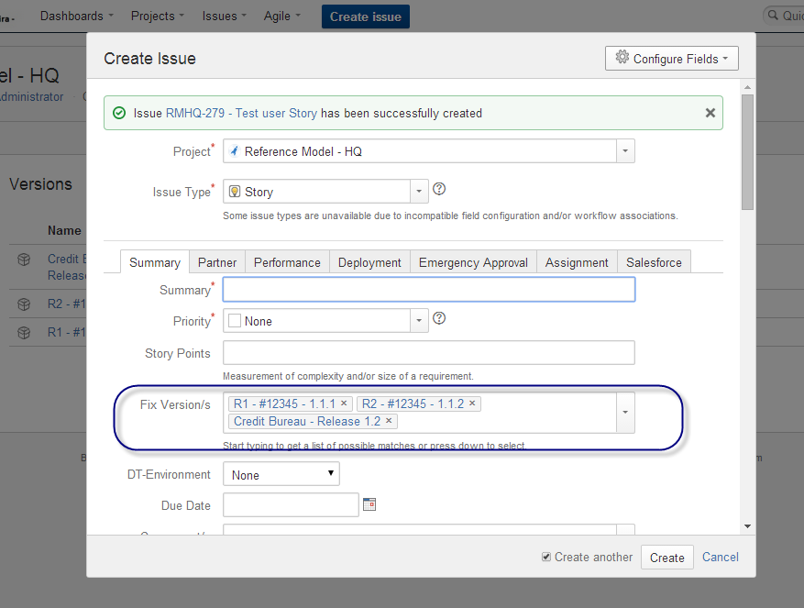
JIRA / Innotas Integration – Search
Use Case 4

